Slide 1
Data validation on data collection software level –improving the system of data quality
Tomaž Cör
Beograd, 15th-16th September 2016

Slide 2
Introduction – Slovenian FADN System
Regional offices (regional level)
Liaison Agency (national level)
FADN Unit in DG Agriculture
Individual farms (906)

Slide 3
Introduction – Slovenian FADN System
  Yearly FADN inventory on farm is made in cooperation between farmers an local advisers.
  Farmers themselves are sending data about finances, livestock and products to the accountancy offices.
  Three different ways of sending the data:
    On paper
    In Excel file
    Directly in FADN application

Slide 4
Different ways of improving the data
  Limits in FADN data controls,
  Good preparation of yearly inventory questionnaires,
  Using official databases,
  Error traps in FADN application.

Slide 5
Limits in FADN data controls
  Every year the national FADN Liaison Agency sends list of limits to EU. What are limits and why are they necessary?
  Limits are values that in certain MS make sense for the individual data.
  For example, the price of apples in Slovenia is somewhere between 0,1 EUR for industrial apples and 3,5 EUR for organic production.
  If the RICA system finds higher or lower value, they will send us warning and we will have to check it and make correction or clarification.

Slide 6
Limits in FADN data controls
  Limits are very useful to show us the outliers. Outliers are possible typing mistakes, mistakes in entrance of measurement units…
  One extreme outlier can change the economic picture of the entire cluster of farms.
  If we see a lot of outliers on certain data that are not mistakes, it is better to change limits than to write many clarifications.

Slide 7
Good preparation of yearly inventory questionnaires
  Pricelist for old agricultural machinery;
  Prepared estimations for values of buildings.
  Additional questions about labor;
  Additional questions about ratio between household and agriculture;
  Calculations between measurement units.

Slide 8
Using official databases
  In Slovenian FADN System we use official databases for
    Cattle movement
    Land in use
    Subsidies

Slide 9
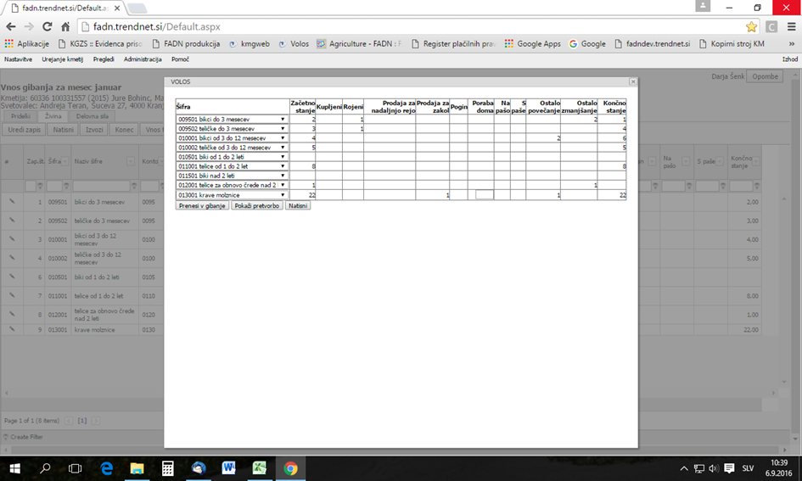
Using official databases

Slide 10
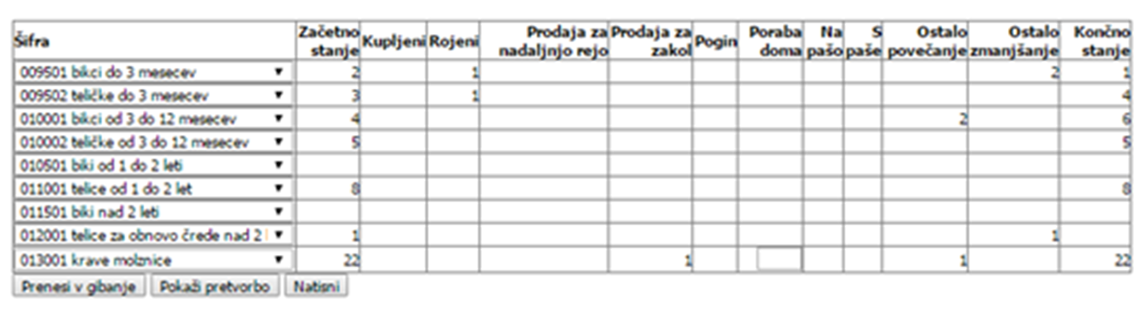
Using official databases

Slide 11
Error traps in FADN application
  Error traps prevent us from typing or logical errors in the process of entering the data.
  Two sets of error trapping:
    Error trapping at the entering of the reports (livestock, products, money)
    Error trapping at the entering of the yearly inventories.

Slide 12
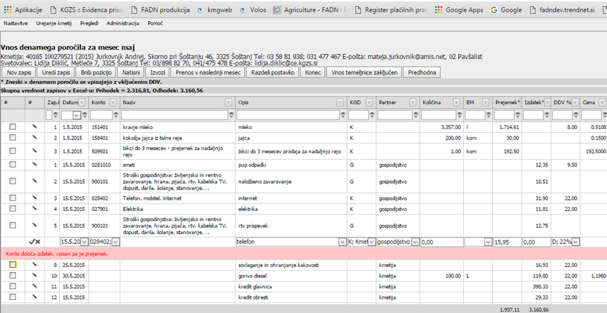
Error traps in FADN application
  Income – cost mistake

Slide 13
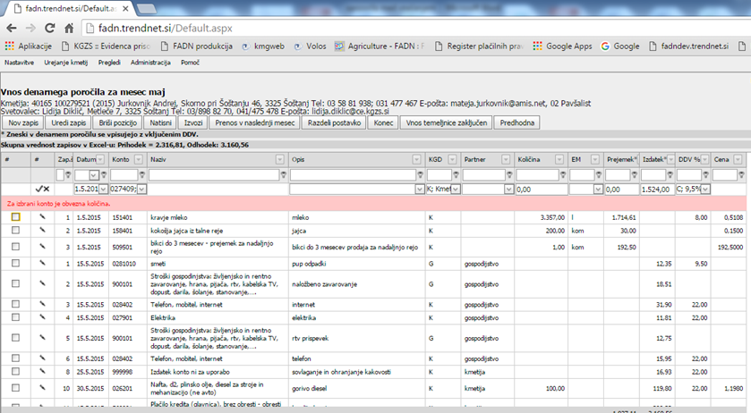
Error traps in FADN application
  Missing quantities

Slide 14
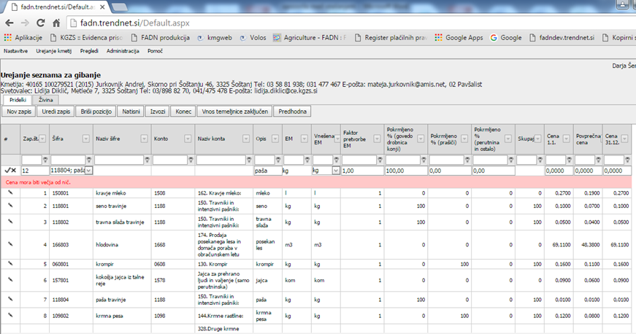
Error traps in FADN application
  Missing prices

Slide 15
Error traps in FADN application
  Missing price

Slide 16
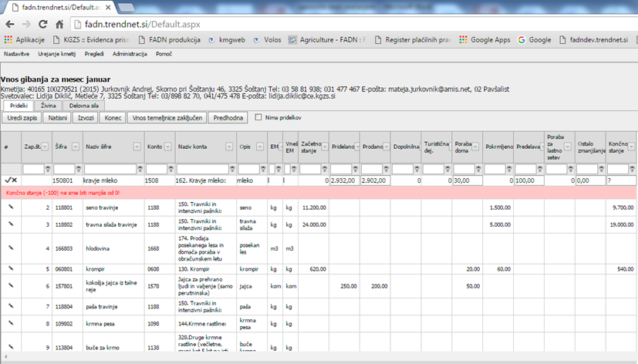
Error traps in FADN application
  Stock at the end of transaction should not be below 0

Slide 17
Error traps in FADN application
  The application already blocks certain input fields.
  For example hay can not be registered under „Consumption at home“. If the farm has not registered farm tourism, data can not be entered into the column "Tourist activity“. In animals section only with the smallest categories (calves up to 3 months, lambs, piglets ...) it is possible to enter in the column „Born„. In the largest category (cows, bulls over 2 years ago ...) we can not enter the „Other reduction“, which is used exclusively for the transition to a higher category.

Slide 18
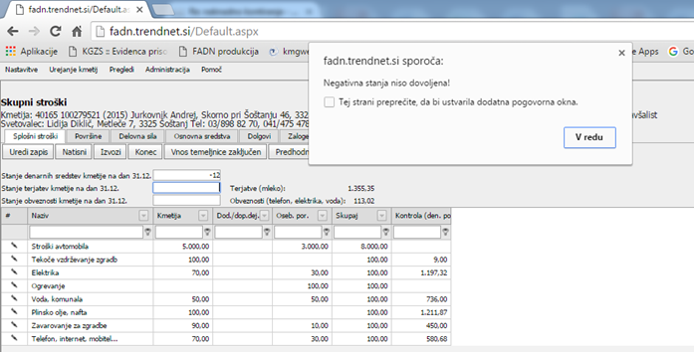
Error traps in FADN application
  Negative „money in the pocket“

Slide 19
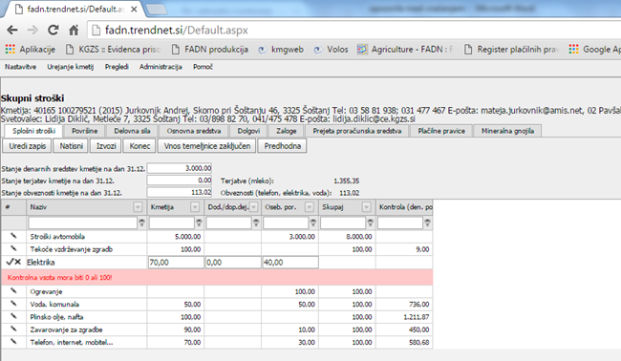
Error traps in FADN application
  Ratio between farm and household - no 110 %!

Slide 20
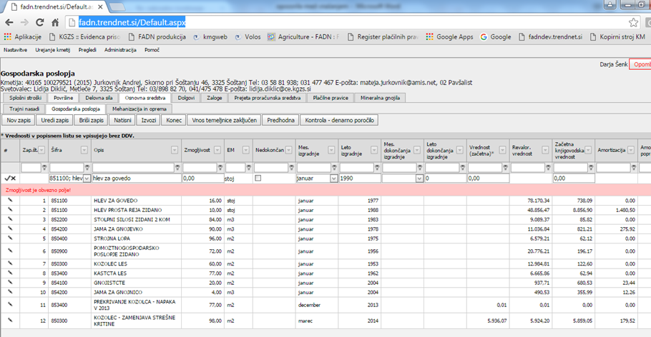
Error traps in FADN application
  Enter of the capacity of buildings is necessary!

Slide 21
Error traps in FADN application
  One of the most important error traps checkes if the transaction (purchase or sell) in the livestock or product section is registered in the accountancy section.
  For example, in official register called VOLOS, farmer has reported that he bought a cow and he transferred the serial number to his own register.
  But he did not report any costs for this cow. Even more often is, that he „forgot“ to register the money he received for the sell.

Slide 22
Error traps in FADN application
  List of errors at the end of the entering

Slide 23
Conclusions
  If we want to have good quality FADN data we should introduce some tests and error traps on all stages of data entry. Tests and error traps should be performed by the application for entering the data.
  Application should produce as many instant blockades or messages as possible.
  Smart set of limits is important to find the outliers on one hand and reduce the number off clarifications. With this, the work on data processing is less time consuming and therefore CHEAPER!

Slide 24
Thank you for your attention!

